Slide 1
APPLIED SYSTEM SOFTWARE
SARL Lem-Cloudtech

Slide 2
01
02
03
SDLC
Overview and Motivation
Gathering & Analysis
Lem-Cloudtech

Slide 3
04
05
06
System and Software Design
Implementation Phase
Software Requirements Specification
Lem-Cloudtech

Slide 4
07
08
09
Testing Strategy
Test Results and Validation
Challenges and Lessons Learned
Lem-Cloudtech

Slide 5
10
11
Demo Overview
Conclusion and Future Work
Lem-Cloudtech

Slide 6
Overview and Motivation
01

Slide 7
Overview and Motivation
Motivation :
This is a real-world project requested by an existing company, which adds value and realism.
It offers a complete practical case to apply a full Software Development Life Cycle (SDLC).
It’s an opportunity to implement skills in UI/UX design, web development, and content management.
The project allows us to think about usability, visual identity, and how to effectively communicate tech expertise online.
Overview :
Build a modern, user-friendly website that clearly showcases the company's two main services:
IT consulting
Training, with a focus on Microsoft cloud technologies
The client should easily publish :
A list of available training courses, with detailed descriptions
Projects the company has worked on
Technology watch videos for continuous learning

Slide 8
SDLC
02

Slide 9

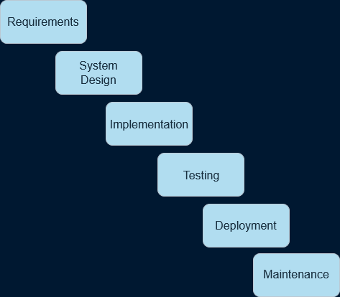
SDLC ( Software Development Life Cycle )

Slide 10
03
Gathering & Analysis

Slide 11
Requirements Gathering
Requirements Analysis
•⁠ The site needs to serve two purposes:
promotion (showcasing services) and information (listing trainings and projects).
•⁠ Content must be modular and updatable, suggesting a possible need for dynamic pages or a CMS.
•⁠ Strong emphasis on visual presentation, meaning UX/UI design is critical.
•⁠ ⁠No user login system required at this stage keeps the scope focused.
Collected directly from the client’s detailed email an from regular meetings with the client.
⁠Organized the content into functional and non-functional needs.
Interpreted implied expectations (needing ease of content updates → CMS option).
Optionally, clarified points (target audience, priority features).

Slide 12
04
Software Requirements Specification

Slide 13
1-Functional Requirements
Homepage :
Introduces the company and its mission
Services Section that highlights main services: IT consulting & Microsoft cloud and training programs
Displays a list of training courses
Each course has a title, description, and duration
Projects Section
Lists recent consulting or training projects
Each project includes a short description and the tech used
Video Section
Embeds or links to watch videos
Allows users to view content directly on the website
Contact Section
Includes basic contact info (address, email)
Contact form

Slide 14
2-Non-Functional Requirements
4-System Architecture
Professional and clean design matching the company’s branding
Responsive layout for desktop, tablet, and mobile
All content presented in French
Fast loading time, lightweight pages with optimized CSS
Maintainable structure with reusable CSS classes and clear folder hierarchy
Purely client-side architecture
Organized into:
﻿﻿Edge.html (Homepage)
style.css (Stylesheet)
Mention légale.html (Legal Notice)
politique.html (Privacy Policy)
active.js (for dynamic features)
Send_email.php (for the contact form)
Folder images (to contain the images put on the website)
3-Technology Stack
Frontend: HTML5, CSS3
BackEnd : JavaScript, PHP
Lightweight and accessible for all modern browser

Slide 15
System and Software Design
05

Slide 16
3-Main Pages
1-Architecture
Purely client-side architecture
HomePage
- Services Section
- Project Section
- Video Section
- Contact Form
Legal Notice Page
Privacy Policy
Professional and clean design matching the company’s branding
Responsive layout for desktop, tablet, and mobile
All content presented in French
Fast loading time, lightweight pages with optimized CSS
Maintainable structure with reusable CSS classes and clear folder hierarchy
4-Design Choices and UI
2-Tech Stack
Fully responsive layout (mobile & desktop)
Clear and simple navigation
Consistent structure (header, content, footer)
Clarity, speed, and ease of access to key information.
Frontend: HTML5, CSS3
BackEnd : JavaScript, PHP
Lightweight and accessible via any modern browser

Slide 17
Implementation Phase
06

Slide 18
1-Development tools
VS Code exclusively, and then GitHub for version control
4-Code Structure
2-Approach
Clear folder hierarchy: all pages together and /images,
Reusable components (e.g., header/footer)
Started with basic HTML structure for each page.
Applied consistent CSS styling across all pages.
Ensured responsive layout using media queries / framework.
5-Collaboration
3-Content Integration
Tasks split between team members (HTML structure, styling, content insertion)
Pushed updates regularly on GitHub for tracking and feedback
Used placeholders for trainings, projects, and videos (waiting on final client data).
Embedded contact details and company info as provided.

Slide 19
Testing Strategy
07

Slide 20
Type of Testing
Tools Used
Manual Testing on different devices (desktop, tablet, mobile)
Browser Compatibility: Tested on Chrome, Firefox, Edge
Responsiveness: Verified using dev tools (responsive view)
Browser DevTools
Mobile device previews
Focus Areas
Issues Fixed
Page navigation and links
Layout consistency across pages
Text readability and alignment
Video embedding functionality
Margin/padding adjustments
Image scaling on smaller screens

Slide 21
Test Results and Validation
08

Slide 22


All main features worked as expected
Validation Checks
Feedback
Navigation between pages
Content display (texts, images, videos)
Responsive design on different screen sizes
HTML and CSS validated
No major accessibility or formatting errors detected
Team internally reviewed the site and made minor improvements
Client previewed the site and confirmed it aligned with expectations

Slide 23
09
Challenges and Lessons Learned

Slide 24
Challenges | Lessons Learned
Limited content from client → We used placeholder content while waiting Short timeline → Had to prioritize essential pages first Design decisions → Balancing simplicity with professional look | Real-world clients may not always give full specs → Importance of clear communication Planning is crucial when time is limited Simple tools (HTML/CSS) can still deliver professional results if used smartly Importance of responsive design and testing on multiple devices

Slide 25
10
Demo Overview and highlight

Slide 26
Overview
Section | Description
Homepage | Company introduction and clear presentation of services (consulting & training)
Training Section | List of available courses with short descriptions
Projects Accordion | Showcases past projects + technologies/tools used
Video Section | Embedded tech watch videos (from YouTube or local sources), for now, no videos added
Contact Section | Company address and email (no contact form implemented yet)
Highlights
Focus Area | Details
Clean & Professional Design | Simple, readable, and well-organized layout
Mobile Responsiveness | Works well on various screen sizes
Smooth Navigation | Easy transitions between pages

Slide 27
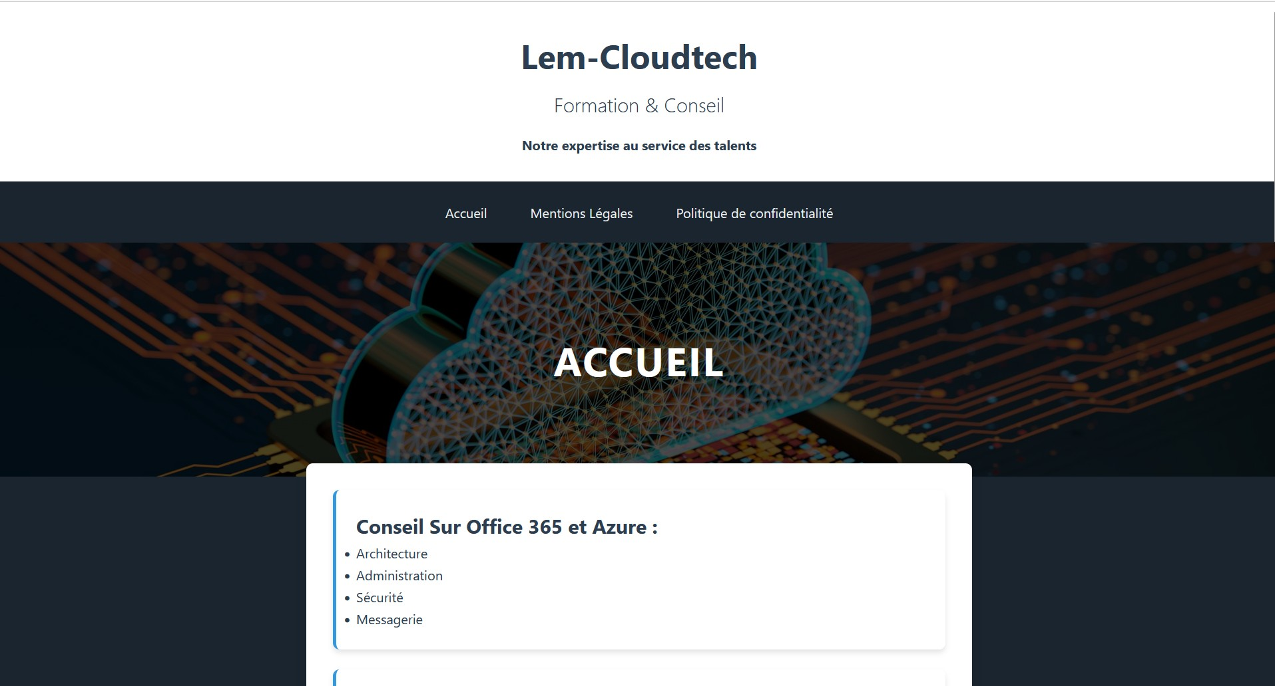
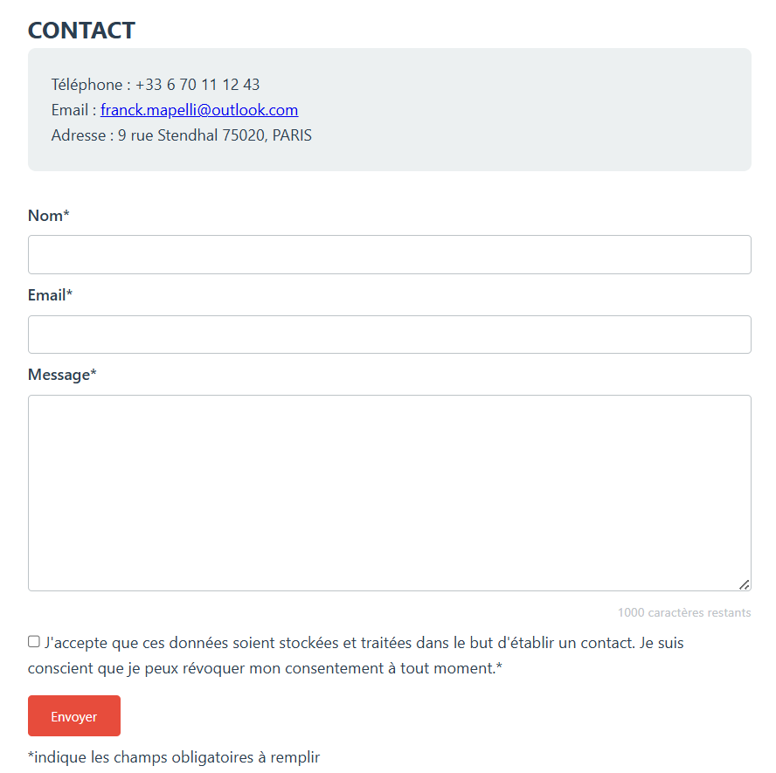
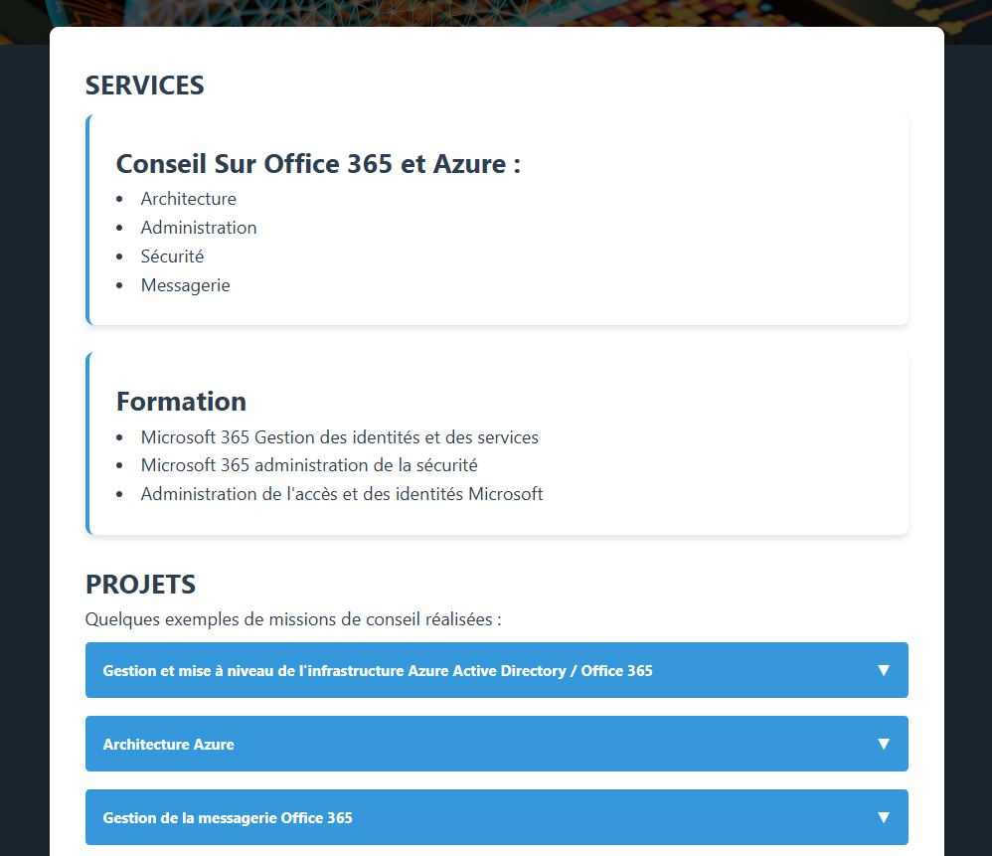

Slide 28
11
Conclusion and Future Work

Slide 29
CONCLUSION
Successfully delivered a clean, responsive dynamic tailored to the client’s needs
Focused on clarity, professionalism, and simplicity
Applied full SDLC process from planning to testing
FUTURE WORK
Enable CMS or admin panel for easier content updates
Improve SEO and accessibility
Possibly add multi-language support (English/French), but not asked yet by the customer

